Slide 1
Real-Time Object Detection App – सहायक (Sahaayak)

Slide 2
Motivation
This project revolves around the problems faced by non-native English speakers.
Many times, non-native people get stuck while describing a particular object.
That is where our app comes to the rescue.

Slide 3


HELLO!
Mohak Patel
ECE Department
mohak@pdx.edu
Archit Tatwawadi
ECE Department
archit2@pdx.edu

Slide 4
Real-Time Object Detection App
Splash Screen - Animated splash screen
Login Screen - Secured log in with firebase
Sign Up Screen - New user registration
Camera Screen - Object Detection

Slide 5
Design and Implementation

Slide 6

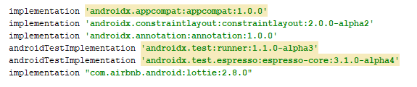
Splash Screen - Lottie Animation
It’s free..!!
Animation requires the androidx module
Thus we migrated from android to androidx to implement the Lottie animation
Required dependencies are added to the build.gradle (app module) :
Hide the system notification bar for full-screen utilization

Slide 7


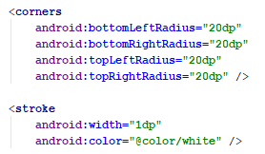
Login Screen- Design
We implemented the different XML file for the layout
Ex. Buttons background – Login and Signup,
EditText background with icons,
Gradient background, Vector image
Progress Bar
Sign Up Button – Transparent background

Slide 8
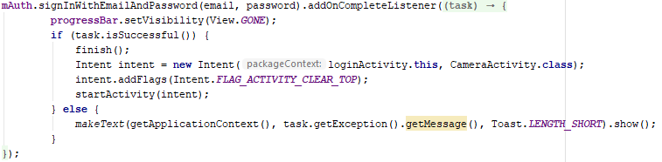
Login Screen- Implementation
Firebase Authentication
Creates the instance of firebase authentication and verifies the user by passing the email and password to the signInwithEmailAndPassword:
Incorrect email and password - Error

Slide 9


Sign up Screen
Creates the instance of firebase authentication and verifies the user by passing the email and password to the createUserWithEmailAndPassword:
Error :
Empty fields
Email pattern not match
Password length < 6
Password does not match with confirm password
User already registered

Slide 10
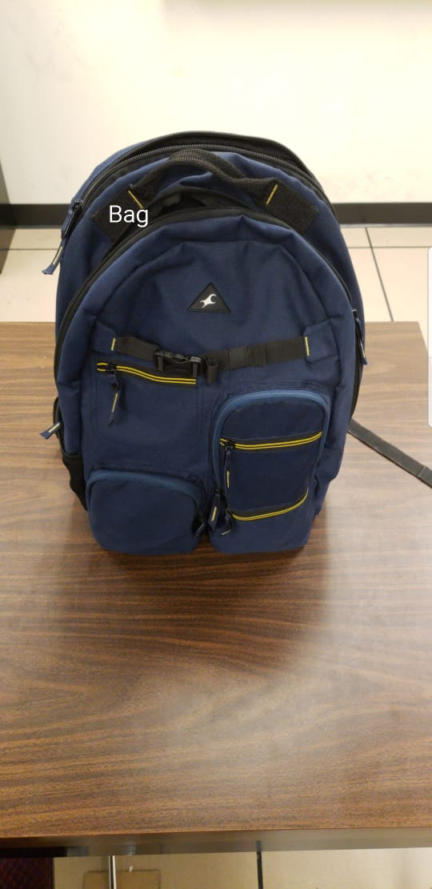

Camera Screen-Threading
Camera preview on screen (Background thread)
Real time object detection – ML Kit (UI thread)
Overlay the detected object label (UI thread)
Gesture based onTouch event listener for speech
Text to speech synthesis for label
Required permission in AndroidManifest.xml:

Slide 11


Camera Screen-Background Thread
Camera opens in a background thread, so that main thread will not overload (Ex. Handling of large pixel arrays will hinder other events)
HandlerThread: Handy class for starting a new thread that has a looper. The looper can then be used to create handler classes. Note that start() must still be called.
And invoke the background thread in onResume method.

Slide 12
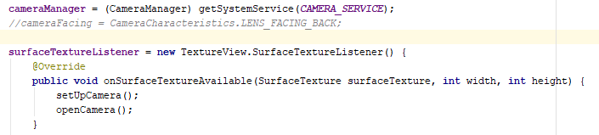
Camera Screen
To access the camera, we used the camera2 API
It requires the texture view to access the camera
By defining the camera facing (front or back) and surfaceTextureListener, we open the camera for object detection. The snippet of code to access the camera2 API:

Slide 13
Camera Screen- ML kit
ML kit available for image labeling: 1. On Device 2.Cloud base
Advantage: no additional training required
We are using the on-device firebase ML kit for object detection.
So when user will download the app, it will automatically download the ML model from the firebase for image labeling.
Pros and Cons:
Faster than cloud base
Less number of object labels
Required more memory on device (~ 33 Mb)

Slide 14

Camera Screen- ML kit
For the object detection using the firebase ML kit, first add the ML dependencies in build.gradle.
Declaration required to configure app to automatically download the ML model to the device after your app is installed from the Play Store

Slide 15

Camera Screen- ML kit
First, we create the FirebaseLabelDetector object for the label detection of the object.
Which set the threshold for object detection confidence. In this case, it is 0.8.
After that, we create the FirebaseVisionImage object to read the bitmap image captured by the camera and created the FirebaseVisionLabelDetector instance.

Slide 16
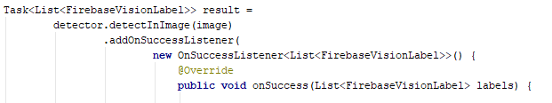
Camera Screen- ML kit
We pass that image to the detectInImage method to get the label for object.
Which return the label for detected object.

Slide 17

Camera Screen- onTouch event
OnTouch event listener for speech
It detect the on touch event and get the label for speech

Slide 18

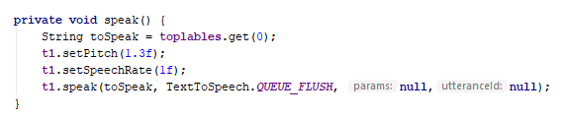
Camera Screen- Text to speech
Android allows us to convert text to speech
First, instantiated the object of TextToSpeech class and then specify the initListener
In that listener, first set the language
After that using the method speak, converts the text to speech

Slide 19
Problem Faced:
Android to Androidx migration.
Implementation of camera2 API.
Difficulty to setup real time object detection
User Suggestions:
User 1: App works perfectly but need support for more languages.
User 2: When the label is displayed, it should display the label in native and English languages.

Slide 20
Work Distribution
Mohak Patel:
Splash screen
Login screen
Signup screen
Setup camera
Archit Tatwawadi:
Firebase ML kit
Object detection
Text to speech
Both work on camera and ML model integration

Slide 21
References:
Lecture notes – Prof. Roy Kravitz
https://firebase.google.com/docs/auth/
https://firebase.google.com/docs/ml-kit/android/label-images#on-device
http://stephendnicholas.com/posts/android-handlerthread
https://developer.android.com/reference/android/speech/tts/TextToSpeech

Slide 22
Demo..!!

Slide 23
Thank you

